Slide 1
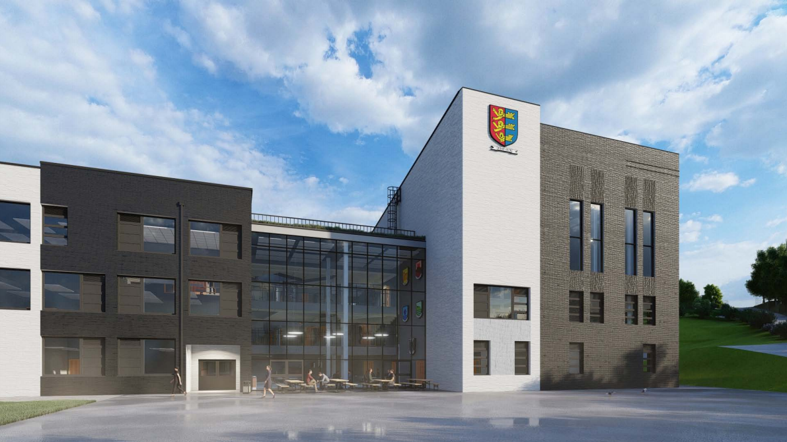
Dover Grammar School for Boys
Admissions - September 2027 Intake
To apply to Dover Grammar School for Boys,
you need to register to take the
Kent Test by Wednesday 1st July 2026 and/ or
the Dover Boys Test by Friday 3rd July 2026
There will be an information event for the Dover Test at DGSB on Wednesday 24th June 2026 at 5pm. Further details will be available on our website in due course.
We will be holding our Year 6 Open Evening on Thursday 1st October 2026.
For further information, including when and how to register for our Year 6 Open Evening, please visit our website: www.dgsb.co.uk closer to the time.

